Slide 1
Iranian Jews in the Twentieth Century: Between Iranian Nationalism, Communism, and Zionism
Lior Sternfeld
Penn State University

Slide 2
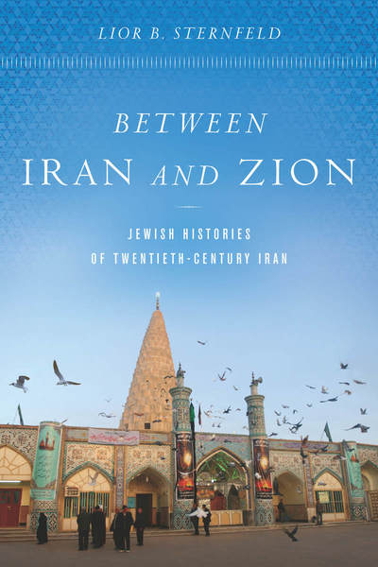

Slide 3
How many Jews live in Iran in 2018? (out of 80 Million)
A. 80,000-100,000
B. less than 2,000
C. 20,000-35,000
D. more than 100,000

Slide 4
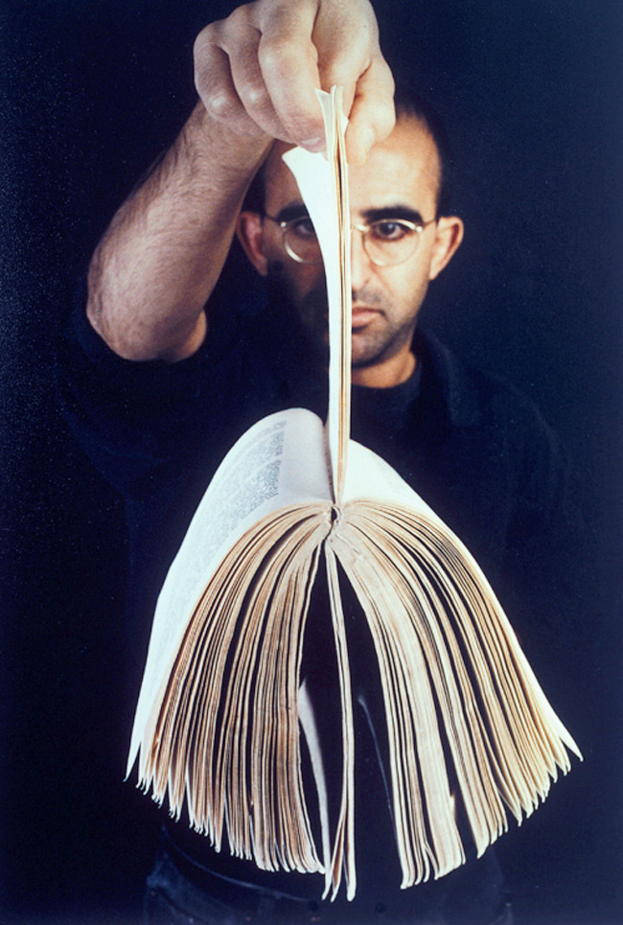
Meir Gal
9 out of 400: The West and the Rest

Slide 5
Searching “Jews Iran History 20th Century” 31 results

Slide 6
Family albums, VHS home videos, M.A. Theses, Judeo-Persian literature

Slide 7
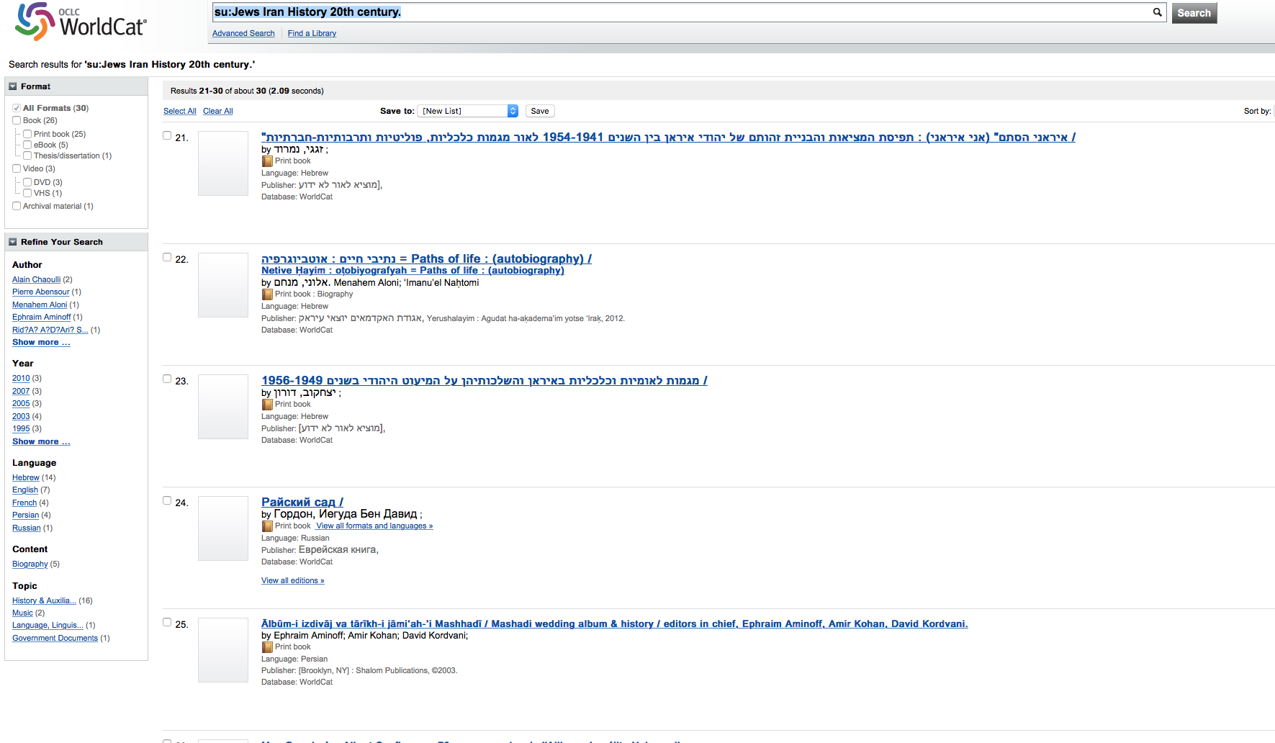

Slide 8
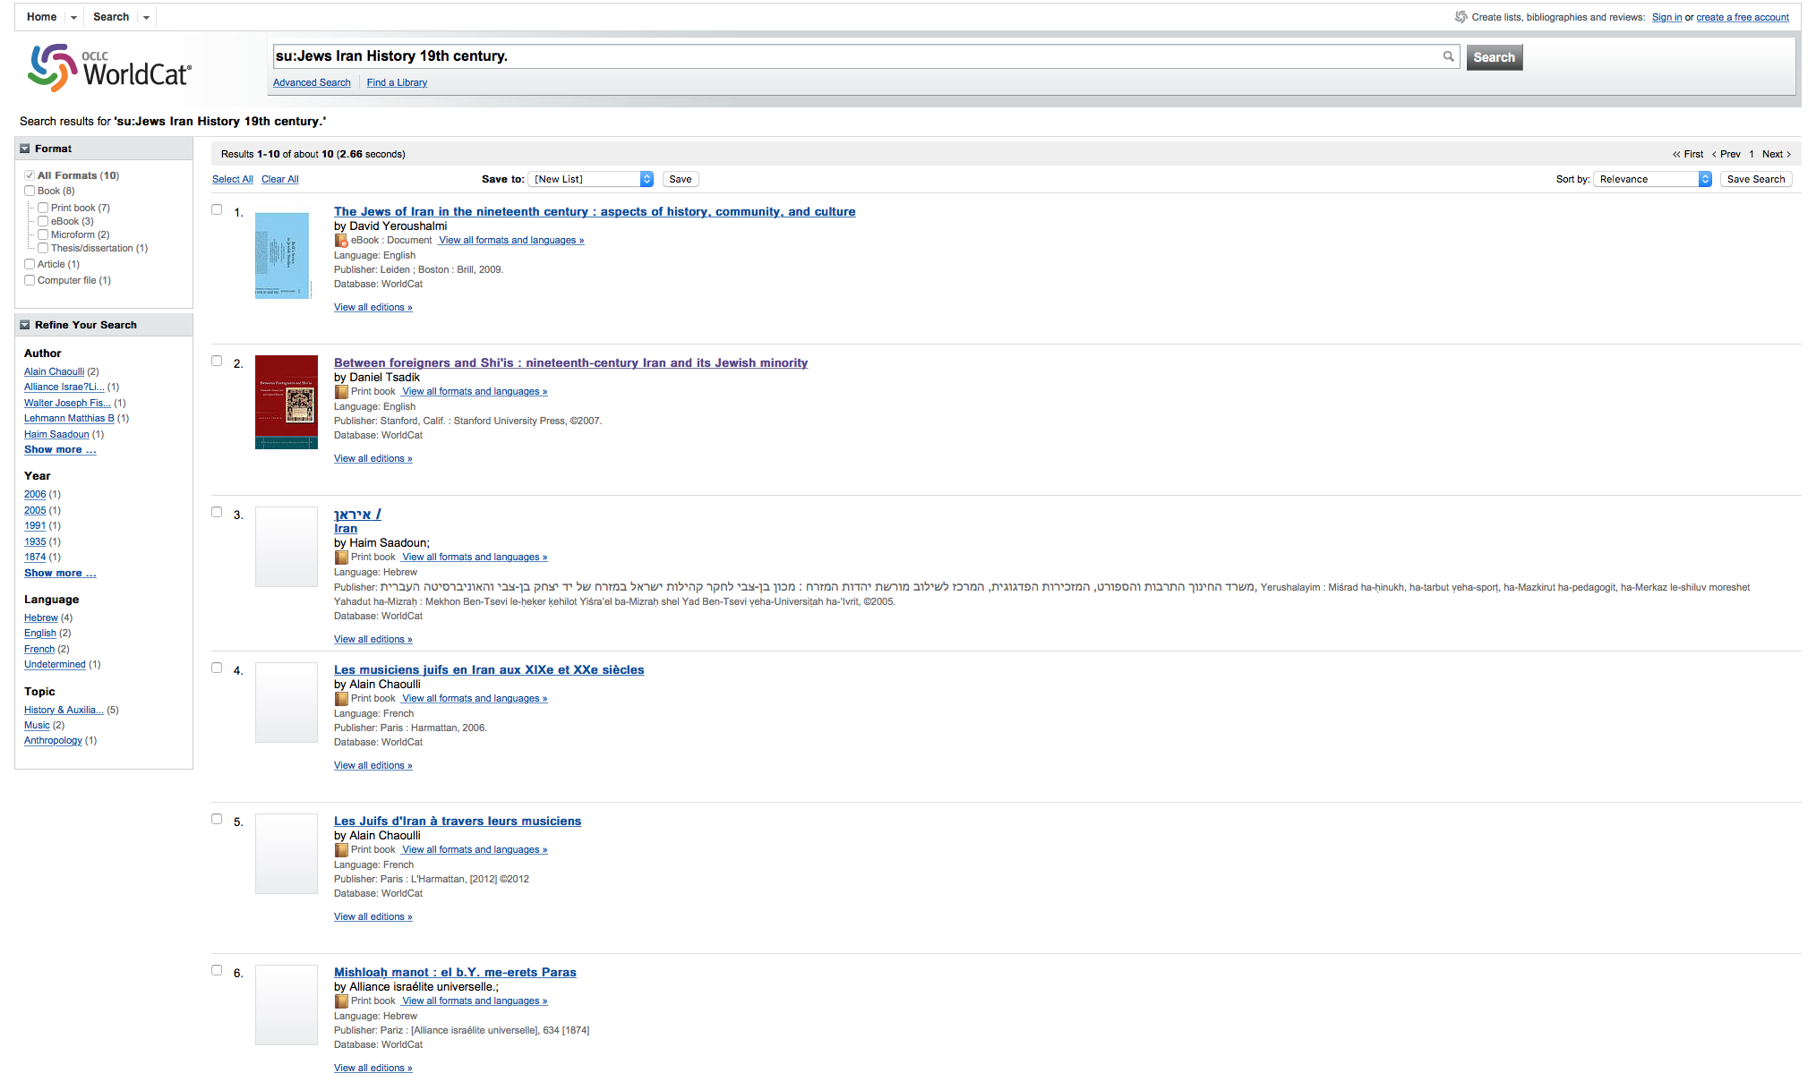
Searching “Jews Iran History 19th Century” 10 results

Slide 9
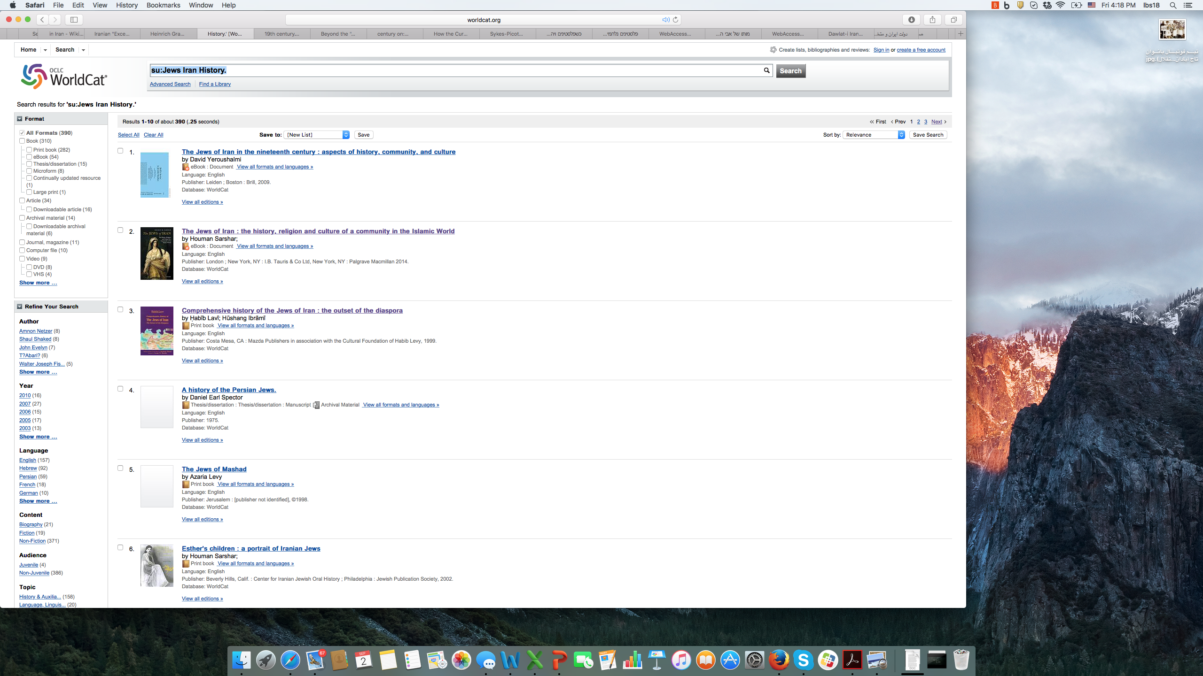
Searching “Jews Iran History” 390 results

Slide 10
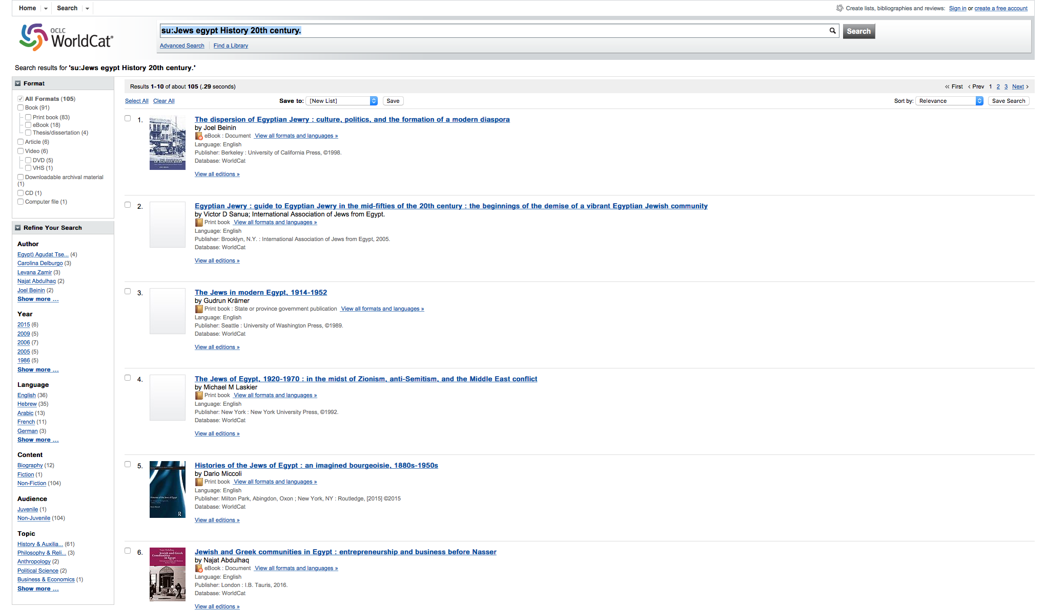
Searching “Jews Egypt History 20th Century” 105 results

Slide 11
Searching “Jews Iraq History 20th Century” 122 results

Slide 12
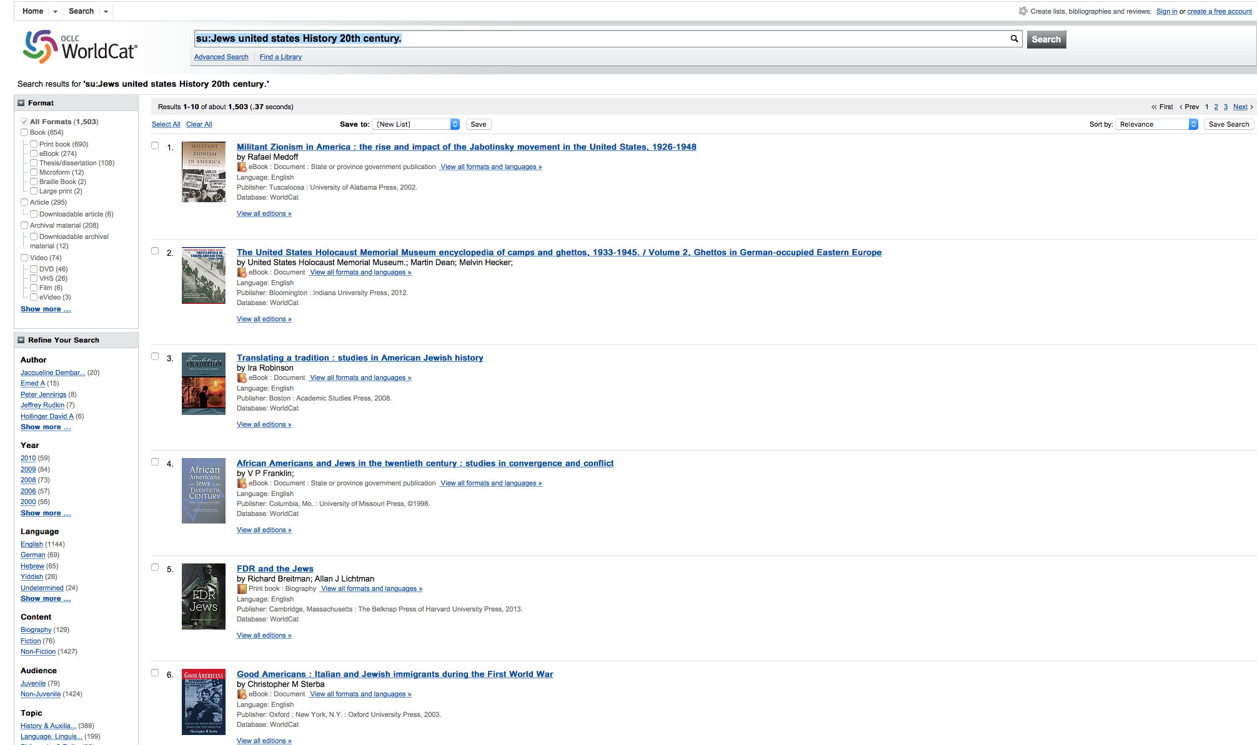
Searching “Jews United States History 20th Century” 1503 results

Slide 13
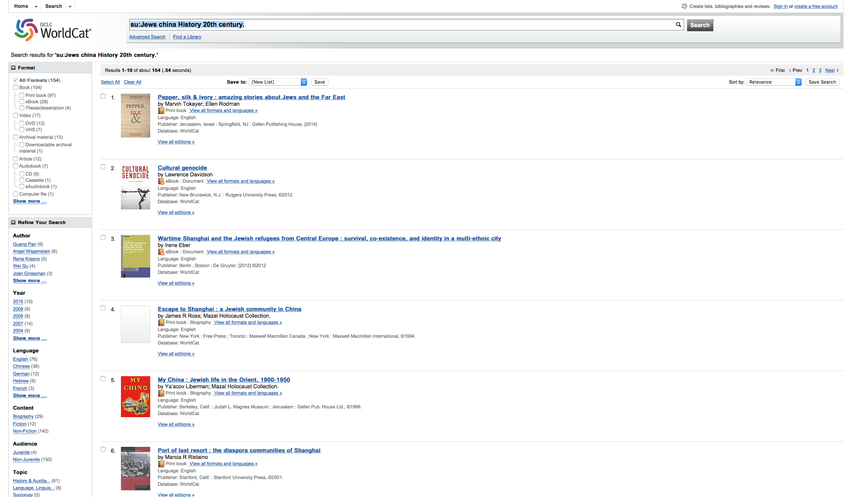
Searching “Jews China History 20th Century” 154 results

Slide 14
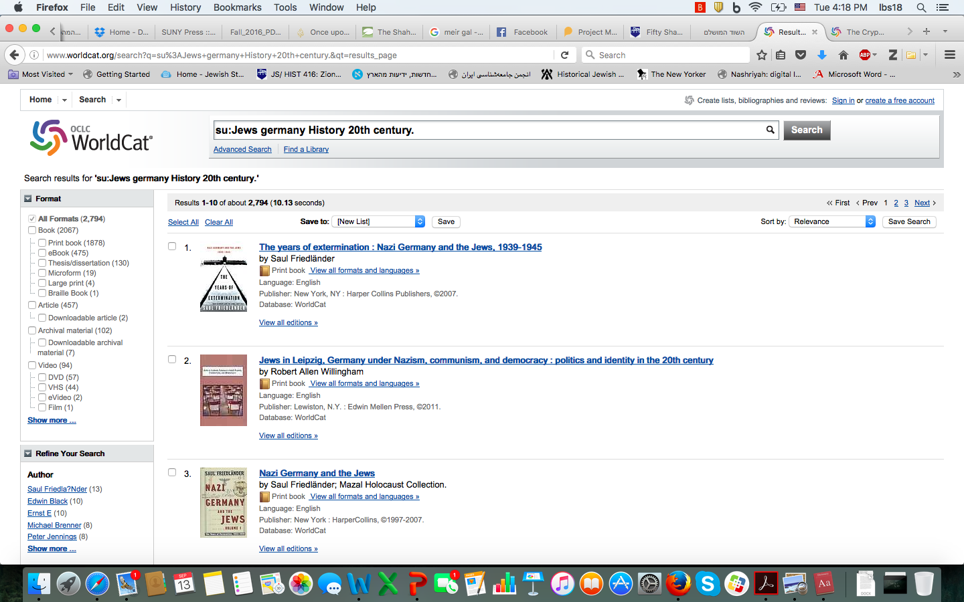
Searching “Jews Germany History 20th Century” 2794 results

Slide 15
Shmuel Haim (1891-1931)
Source: Habib Levy, Comprehensive History of the Jews of Iran: The Outset of the Diaspora

Slide 16
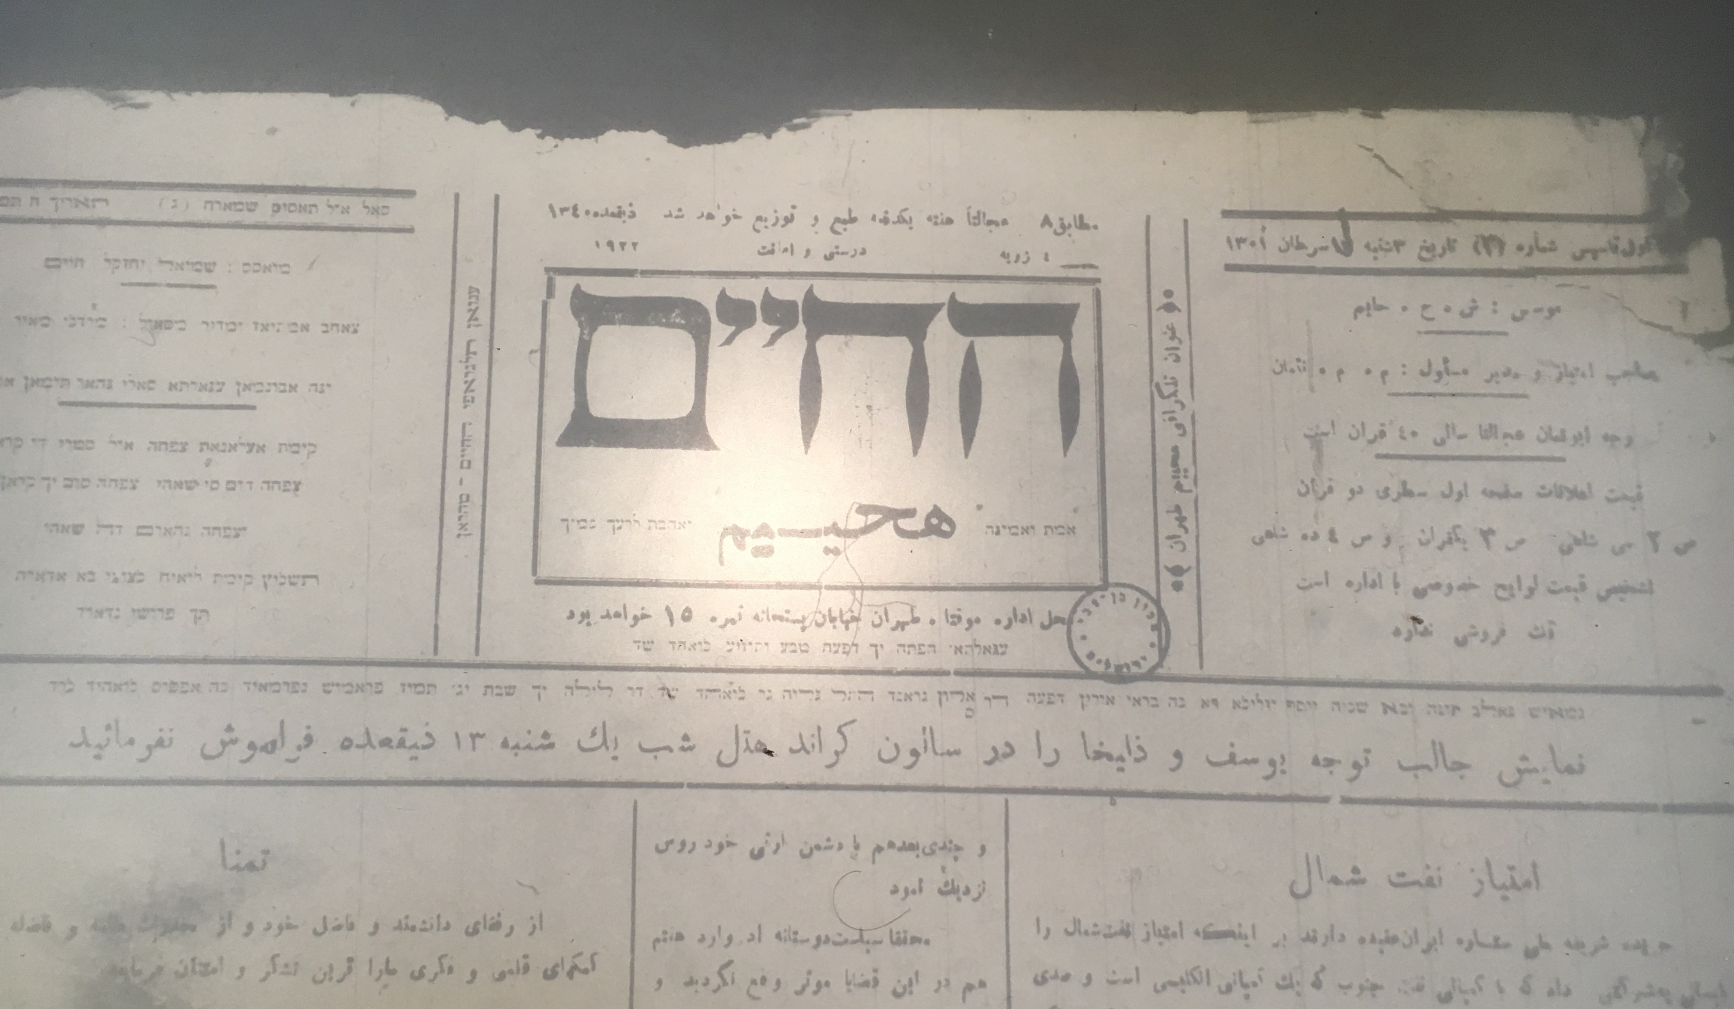
Ha-Hayyim (Life)

Slide 19
Jalal Al-e Ahmad (1923-1969)

Slide 20
Taken from the Guest book at Kibbutz Ayelet Ha-Shahar (1963)
Regardless of the hospitality, I saw here people I have never expected to meet. Learned people, understanding and open-minded. In a sense, they are implementing Plato. Honestly speaking, I always identified Israel with the Kibbutz, and now I understand why.”
Daneshvar: “As I see it the Kibbutz is the answer to the problem of all the countries, including our own.”

Slide 21
Qiblah (from Encyclopedia Britannica)
Qiblah: The Direction of the Sacred Shrine of the Ka’bah in Mecca, Saudi-Arabia, toward which Muslim turn five times each day when performing the Salat (daily ritual prayer)

Slide 22
Tamuz

Slide 23
Anti-Shah demonstrations/ Jewish protest

Slide 24
Sapir Hospital: Love Thy Neighbor As Yourself

